Slide 1

“ToDo-List”
Task - 2

Slide 2

YourꢀProjectꢀName
▪ YourꢀProjectꢀIntroduction
LMS Username
Name
S.KABIL
Batch
2115a812
A8_11

Slide 3

Taskꢀ-ꢀ2
CreateꢀUIꢀandꢀimplementꢀvariousꢀcomponentsꢀusingꢀreact
●
●
●
SplitꢀdesignꢀintoꢀcomponentsꢀandꢀHigherꢀorderꢀComponents
Defineꢀstructureꢀofꢀtheꢀcomponents
Setꢀtheꢀbasicꢀuiꢀcomponentsꢀwithꢀdummyꢀdata
IntegrateꢀtheꢀAPIsꢀtoꢀfrontendꢀtoꢀensureꢀtheꢀdynamicꢀfeatureꢀofꢀwebsite
●
●
●
●
●
Pointꢀbaseꢀapiꢀtoꢀtheꢀseversꢀbaseꢀurlꢀ
Designꢀapiꢀcallsꢀforꢀeachꢀelementꢀ
Handleꢀerrorsꢀinꢀtheꢀoutput
Renderꢀoutputꢀofꢀapisꢀtoꢀdifferentꢀlowꢀlevelꢀcomponents
Secureꢀcontentꢀofꢀpostꢀapisx
EvaluationꢀMetric:
● 100%ꢀCompletionꢀofꢀtheꢀaboveꢀtasks
Learning Outcome
▪
▪
▪
▪
DevelopingꢀcomplicatedꢀUIꢀusingꢀreactꢀcomponents
Usingꢀpropsꢀdrillingꢀandꢀcontextꢀtoꢀpassꢀvariables
Gettingꢀfamiliarꢀwithꢀdifferentꢀtypeꢀofꢀapiꢀcalls
Handlingꢀdifferentꢀinputꢀdata

Slide 4
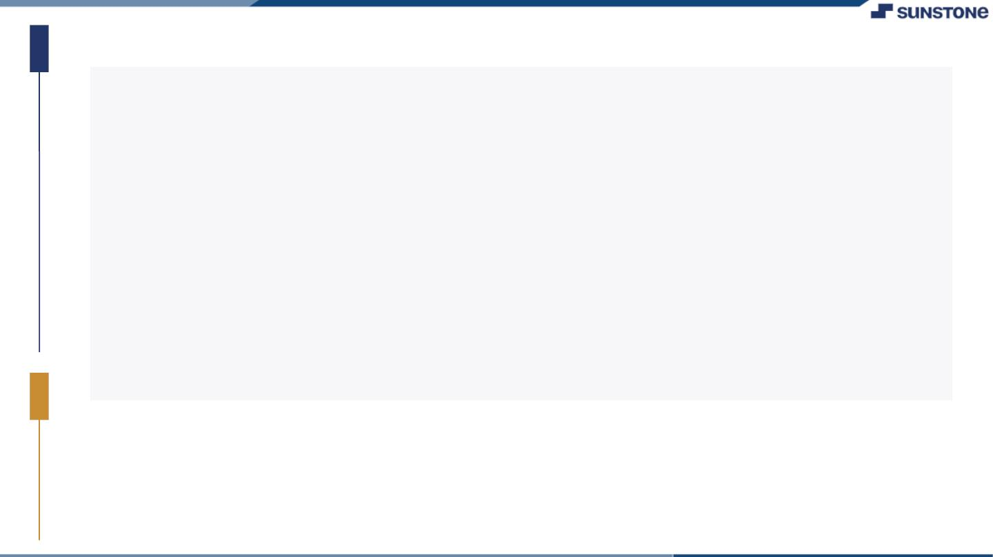
Step-WiseꢀDescription
• Openꢀyourꢀprojectꢀinꢀyourꢀcodeꢀeditor.
• CreateꢀaꢀnewꢀcomponentꢀcalledꢀTodoListꢀusingꢀtheꢀ‘functionꢀ‘ꢀorꢀ‘class’ꢀsyntax.
• InꢀtheꢀTodoListꢀcomponent,ꢀcreateꢀaꢀfunctionꢀcalledꢀ‘addTodo’ꢀthatꢀtakesꢀtext.
• InꢀtheꢀTodoListꢀcomponent,ꢀcreateꢀaꢀfunctionꢀcalledꢀadd.jx,update.jxandꢀotherꢀrequiredꢀ
files.
• Thenꢀdownloadꢀpakagesꢀlikeꢀfontawesomeꢀtoꢀaddꢀextraꢀelementꢀinꢀtheꢀtodolist.
• Addꢀallꢀtheꢀrequiredꢀfunctionalitiesꢀtoꢀitꢀinꢀtheꢀformꢀogꢀfunctonsꢀ&ꢀprops.
• AfterꢀsettingꢀallꢀbasicꢀelementsꢀthenꢀexecuteꢀtheꢀcodeꢀwhichꢀgivesꢀourꢀTodolist.
Summaryꢀofꢀyourꢀtask
• After performing all the above steps we get our own Todolist.
• The frontend of the Todolist is made of basic html &css for Styling.
• Now we can add our Todos in our Todolist.

Slide 5

AssessmentꢀParameter
SetupꢀProjectꢀforꢀCalculatorꢀ
project
Setupꢀbasicꢀstructureꢀofꢀtext-
editorꢀproject
Createꢀaꢀmainꢀcomponentꢀwithꢀtheꢀ
outerꢀstructureꢀofꢀcalculator
Check-List
Createꢀmainꢀcomponentꢀwithꢀ
allꢀfeatureꢀbuttons
Createꢀaꢀbuttonꢀcomponentꢀ
withꢀonꢀclickꢀhandler
Createꢀaꢀjsonꢀobjectꢀtoꢀstoreꢀ
dataꢀforꢀtextꢀeditor
Createꢀaꢀ`ꢀevaluateExpresion`ꢀ
functionꢀtoꢀevaluateꢀvalue
Pushꢀbothꢀcodeꢀtoꢀgithub

Slide 6

Submission Github

Slide 7


